Slide 1
Content of presentation, covering 1) the purpose and context of the project, 2) the project outcomes, and 3) how the outcomes were achieved.

Slide 2

DEVELOPMENT OF CUSTOMER ENERGY PROFILES

Slide 3
Customer Energy Profiles
Energy profiles relate the electricity consumption of customers to the characteristics of their household.
The characteristics used to define the profiles in this project described the social economic situation of the household and were as follows:
Employment Status
Yearly Income
Social Class
Level of Education
Number of Residents

Slide 4
Why Are Energy Profiles Important?
Energy profiles create categories which relate the household characteristics to their consumption.
Meaning that the energy consumption of new customers can be predicted based on their characteristics.
Resulting in:
+ Personalised energy plans for the customer from the supplier
+ Better management of the production as suppliers can predict when large amounts of electricity are going to be consumed and when not so much is needed

Slide 5
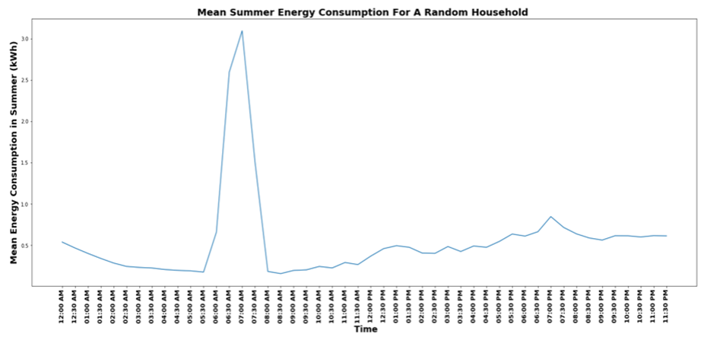
Smart Meters
Smart meters are different to the traditional electricity meter as they use wireless networks to automatically transmit usage data to suppliers. This allows for exact readings and more control over usage.
The energy profiles were created using smart meter readings and questionnaire results collected by the Irish Commission for Energy Regulation.
Meter readings were collected every half an hour over a year and a questionnaire was completed before and after the trial.

Slide 6
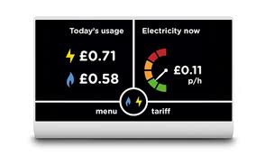
The Lack of Smart Meter Data
Despite smart meter data containing a lot of insight, a major problem is the lack of available data. Reasons for this are down to customers:
+ Unfamiliarity with smart meters
+ Concerned about their privacy/ safety of data
+ Don’t see an economic advantage
In this project, the lack of data has limited the investigation of larger households and personal characteristics such as yearly income.

Slide 7
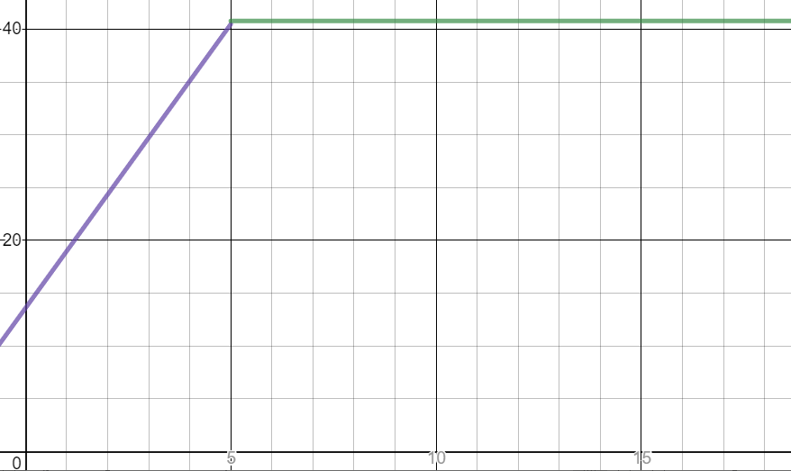
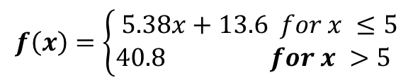
Number of Residents
When organizing the relevant questionnaire data and ensuring it was aligned with the smart meter data, I noticed a significant amount of missing /contradicting data and decided to create a model to estimate the values that were missing.
The graph on the right shows my model, this was created by trial and error of aligning lines with the raw data.
$$f\left(x\right)=\left\{\begin{aligned}& 5.38x+13.6 for x ≤5 \\ &40.8{ for x >5}\end{aligned}\right.$$

Slide 8
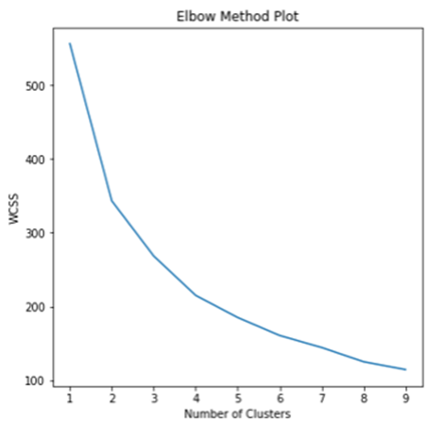
Clustering
To find groups of similar households in the data the K Means clustering algorithm was used. This is an unsupervised algorithm which means unlike a supervised algorithm, there is no desired output – the aim is to find out more about the data.
A key feature of this clustering algorithm is that the number of clusters has to be predetermined. This is done using the Elbow Plot; which plots the different number of clusters against the Within Sum of Squares Measurement (WCSS).

Slide 9
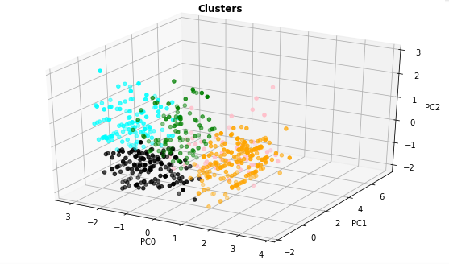
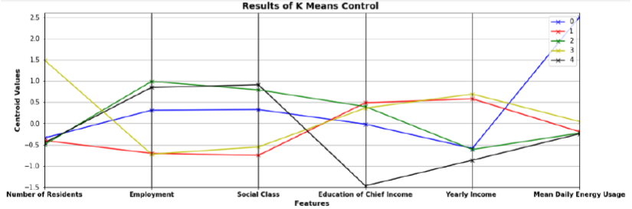
An Example Cluster Result
The clustering analysis was carried out both with and without dimensionality reduction. Using principal component analysis allowed for the data to be reduced into 3 components which were able to be represented on a 3d graph.

Slide 10
Results
This project resulted in six profiles being created (kWh):
1. Retired Single/ Couple
Yearly Income: <30,000 Euros
2. Unemployed Single/Couple
Yearly Income: <30,000 Euros
3. Employed Single/Couple
Yearly Income: 50,000 – 75,000 Euros
4. Employed Family
Yearly Income: 50,000 – 75,000 Euros
5. Employed Single/Couple
Yearly Income: 30,000 – 50,000 Euros
6. Employed Family
Yearly Income: 30,000 – 50,000 Euros
 | Lower Limit | Upper Limit
Yearly | 22 | 40
Summer | 15 | 28
Winter | 30 | 50
 | Lower Limit | Upper Limit
Yearly | 20 | 40
Summer | 10 | 20
Winter | 40 | 60
 | Lower Limit | Upper Limit
Yearly | 60 | 64
Summer | 13 | 21
Winter | 50 | 60
 | Lower Limit | Upper Limit
Yearly | 20 | 30
Summer | 10 | 25
Winter | 20 | 30
 | Lower Limit | Upper Limit
Yearly | 20 | 40
Summer | 20 | 40
Winter | 40 | 50
 | Lower Limit | Upper Limit
Yearly | 20 | 60
Summer | 40 | 60
Winter | 20 | 30

Slide 11


Insights
The electricity consumption increases with the number of residents in the house, but only to a certain point ($≈5)$.
The energy consumption tends to be higher in the winter than in the summer.
Not all of the features selected were relevant, e.g. the education of the chief income earner.
Dimensionality reduction can provide further reduction in data with an already reduced number of features.

